Slide 1
Blender
E-Porfolio

Slide 2
What is blender?
3D Software
Open source
Community project
Combines many features

Slide 3
What are the features of blender?
Soft body simulation
Rendering
UV unwrapping
3D modeling
Sculpting
Rigging and skinning
Texturing
Fluid and smoke simulation
Raster graphics editing
Camera tracking
Animating
Particle simulation

Slide 4
What can you do with all the features?
Some examples and former projects

Slide 5
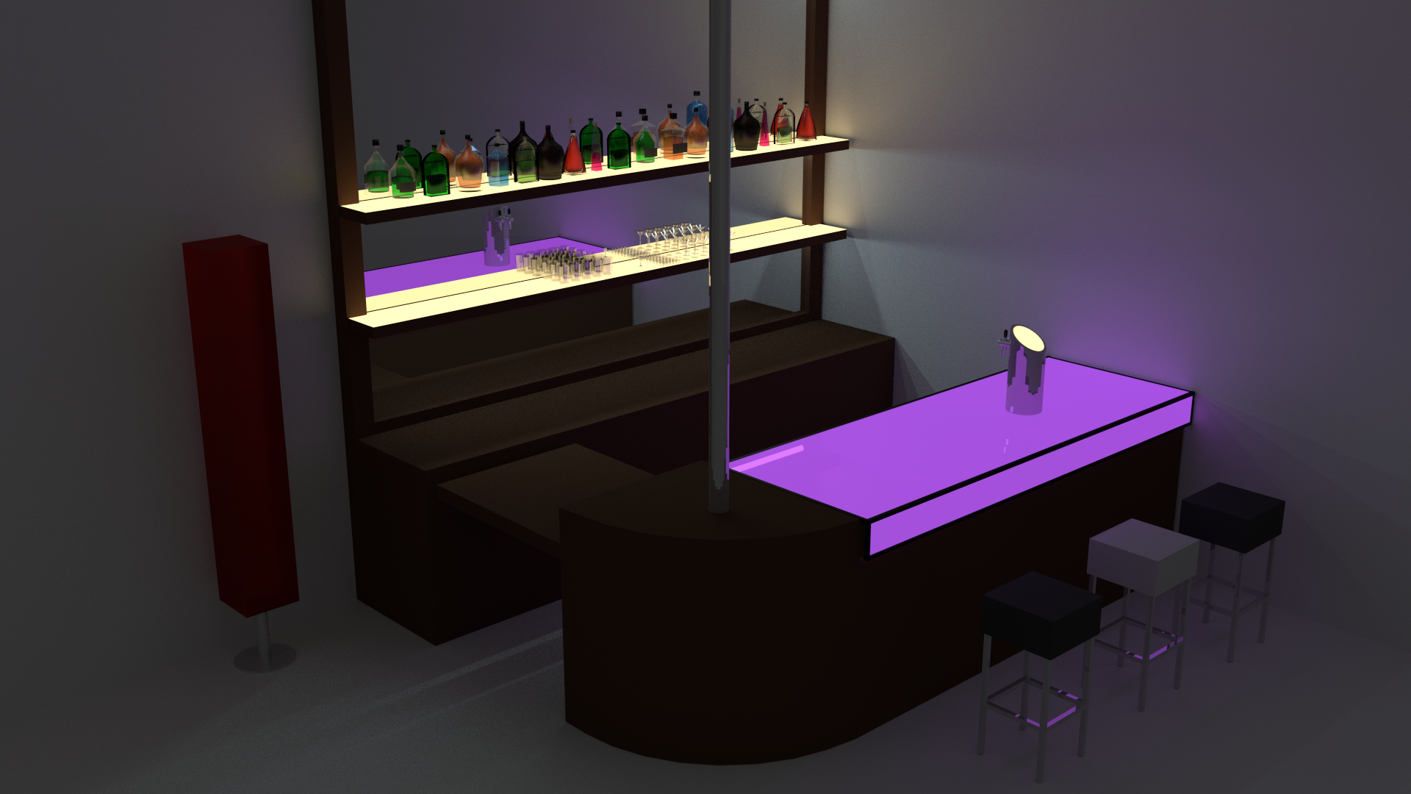
Cycles Render

Slide 6
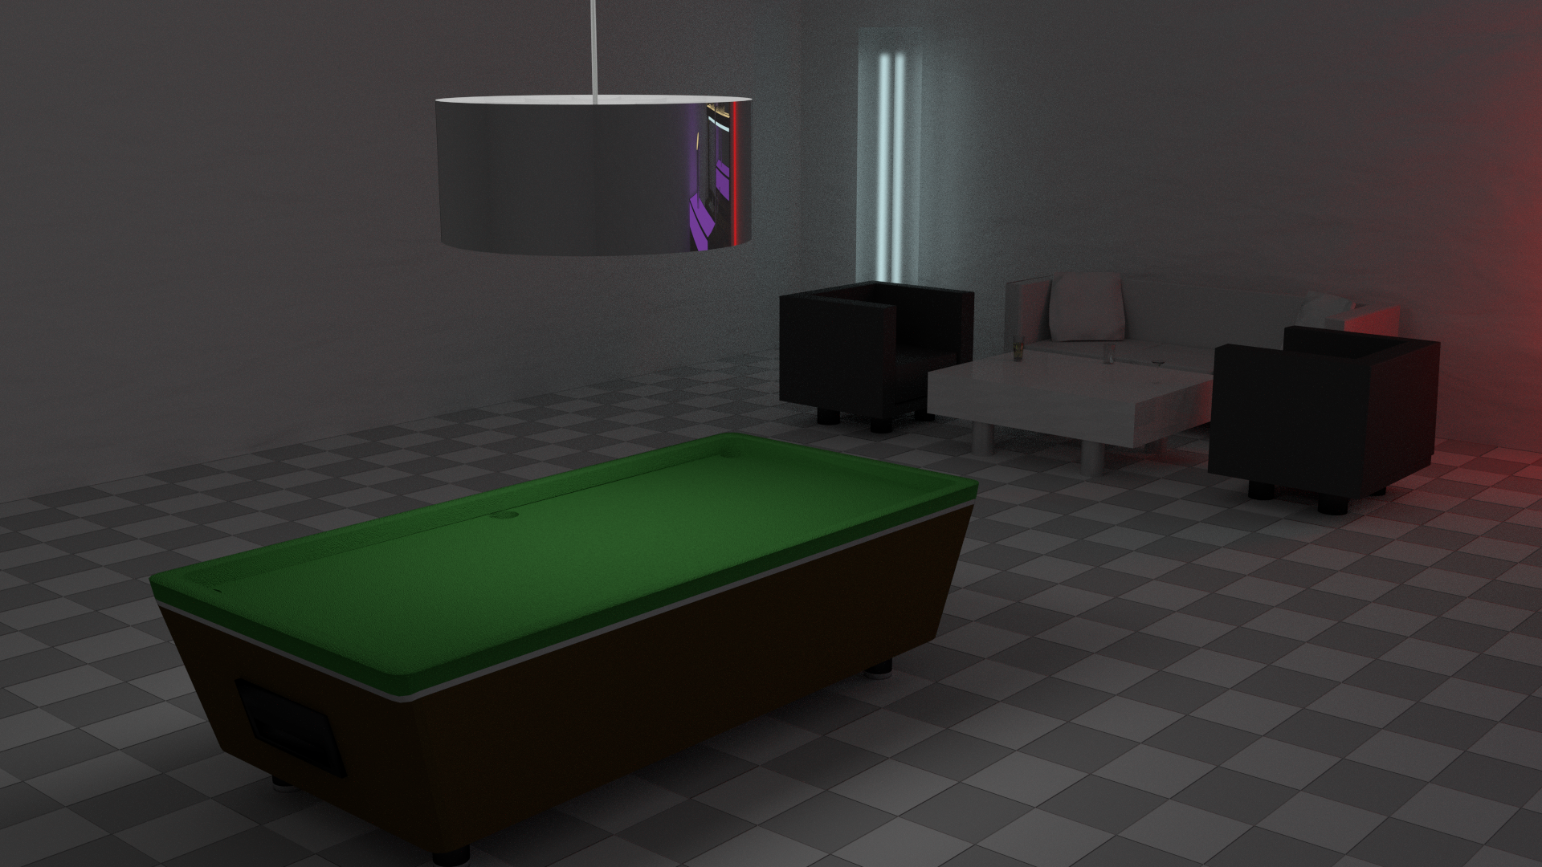
Cycles Render

Slide 7

Particle systems

Slide 8

Particle Systems

Slide 9
Animation and HDR lighting
See Renders Folder for video

Slide 10
How to Learn Blender
YouTube
Paid Courses
Blender Manual
Blender Wiki
Modeling Contests
Just keep going and don’t give up

Slide 11
How to Learn Blender
Don’t just listen to people talking, you have to try it yourself

Slide 12
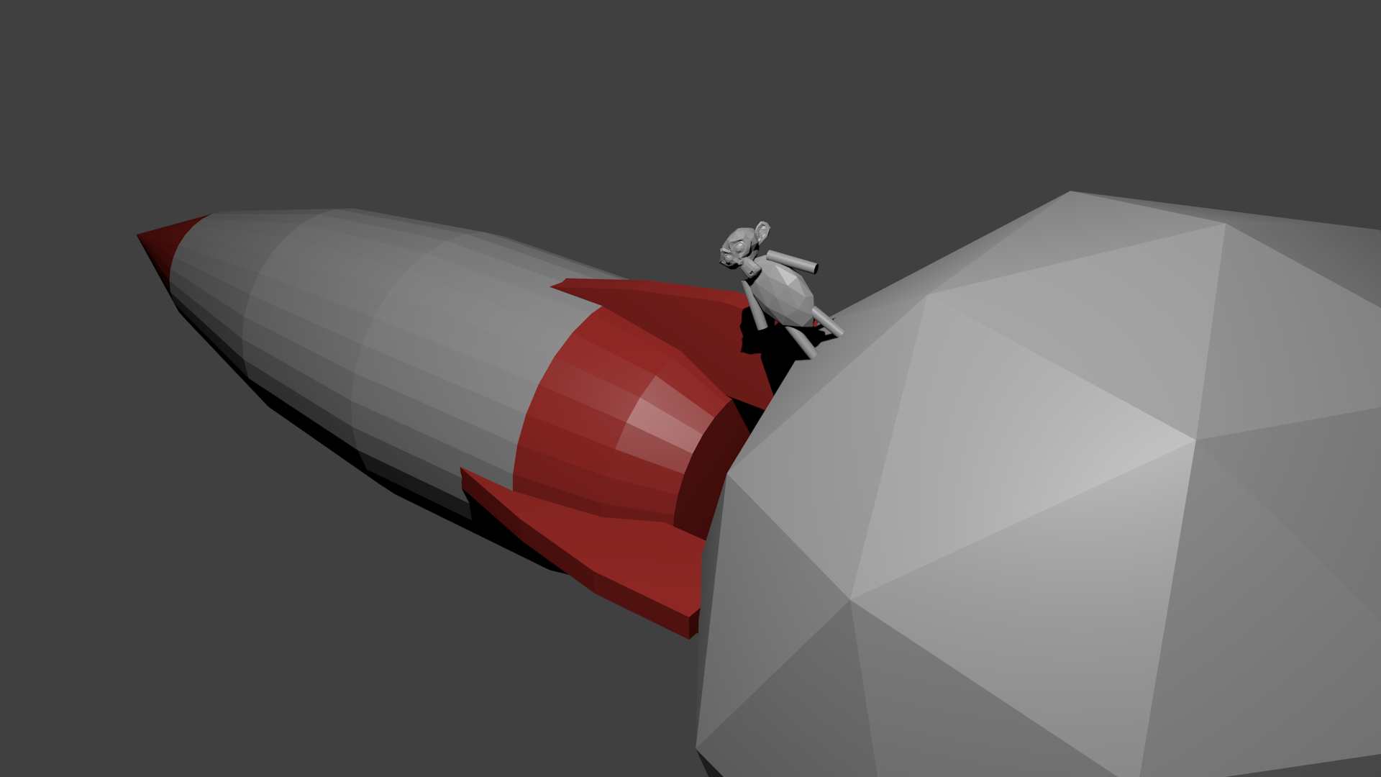
Hands on

